Slide 1
Movie Database Analysis Project

Slide 2
Objective of the Project
Movie Database System helps to analyse and explore the various English movies in last recent years with the following actors acted in a specific movie.
It also shows complete details of directors who directed the corresponding movie
This analysis helps in focussing the genre of movie where we can easily analyse the characters,mood,tone and theme of movie thereby resulting in decision-making.
We can easily relate which directors have directed maximum movies thereby enhancing ease of understanding the outstanding director in the recent years.

Slide 3
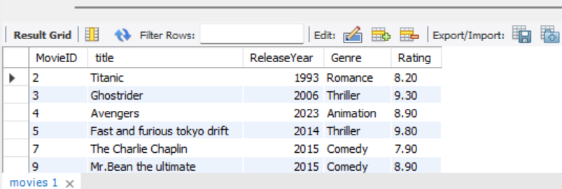
Write a query to select all movies from the Movies table where the Rating is above 7.0.
select * from movies where rating>7;

Slide 4
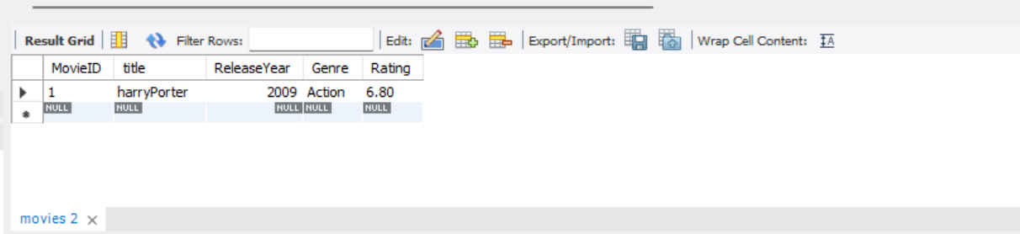
Write a query to select all movies released between 2000 and 2010 and with the genre 'Action'.
select * from movies
where Releaseyear between 2000 and 2010 and genre = 'Action’;

Slide 5
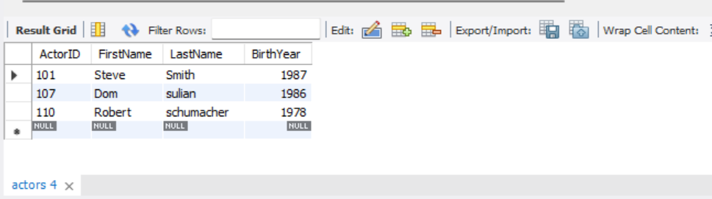
Write a query to select all actors whose Last Name starts with 'S'.
select * from actors
where lastname like 's%’;

Slide 6
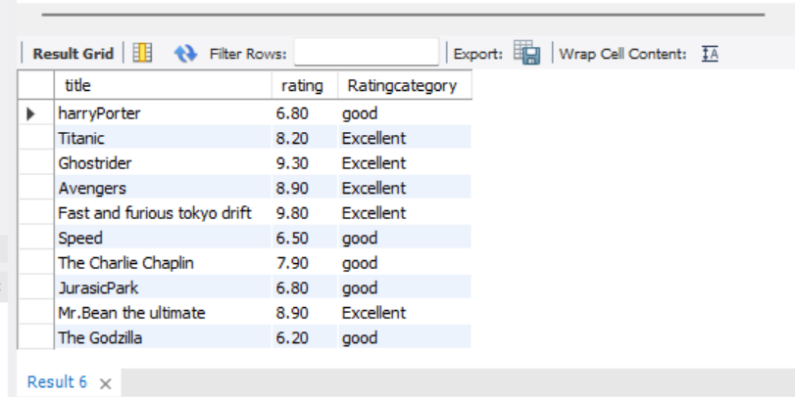
Write a query to select Title and a new column RatingCategory from the Movies table. If Rating is greater than 8.0, set RatingCategory to 'Excellent', otherwise 'Good'.
select title,rating, case when rating > 8 then 'Excellent’ else 'good’ end as Ratingcategory from movies;

Slide 7
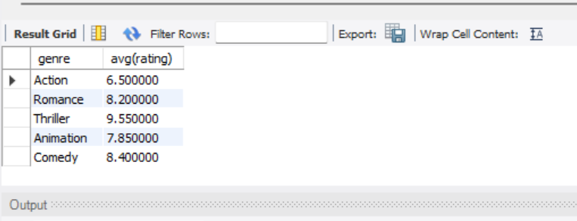
Write a query to get the average Rating for each Genre. Group the results by Genre.
select genre,avg(rating) from movies group by genre;

Slide 8
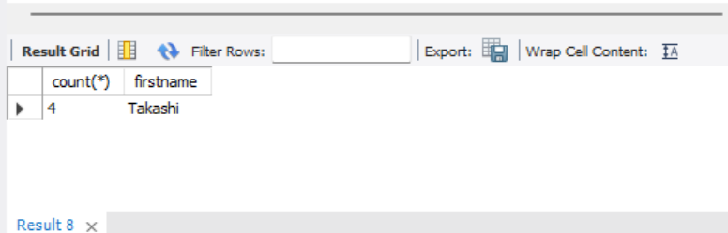
Write a query to get the total number of movies for each director, but only include directors who have directed more than 3 movies. Use the HAVING clause.
select count(*),firstname from directors group by firstname having firstname = 'Takashi’;

Slide 9
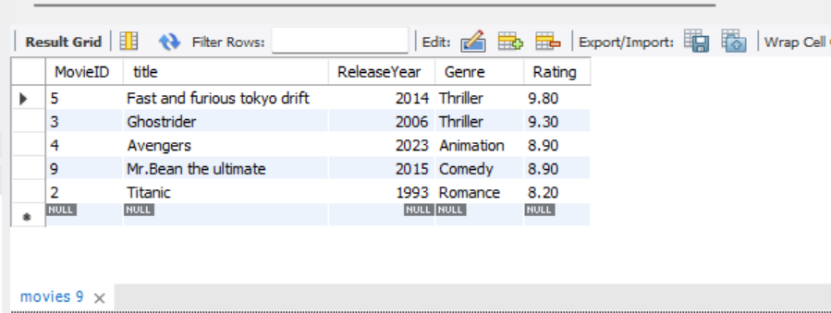
Write a query to select the top 5 highest-rated movies.
select * from movies order by rating desc limit 5;

Slide 10
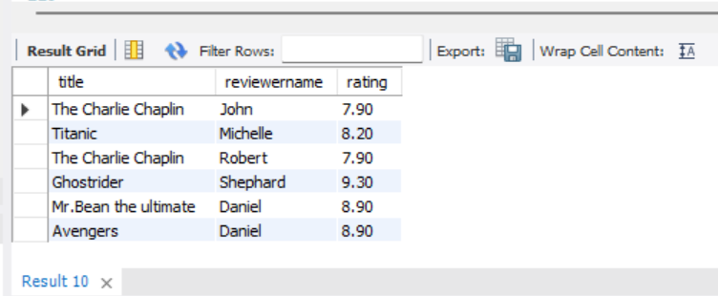
Write a query to join Movies with Reviews to get a list of all movies with their Title, ReviewerName, and Rating.
select title,reviewername,m.rating from movies m join reviews r on m.rating = r.rating;

Slide 11
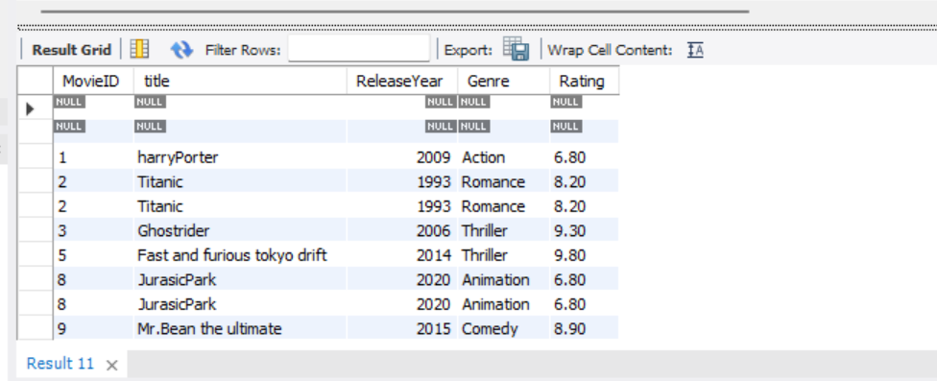
Write a query to get a list of all movies and any associated reviews. Include movies that might not have any reviews.
select m.MovieID,title,ReleaseYear,Genre,m.Rating from movies m right outer join reviews r on m.MovieID = r.MovieID;

Slide 12
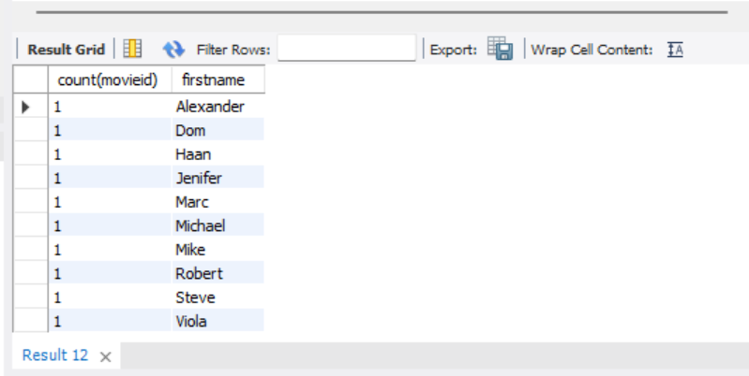
Write a query to get the total number of movies each actor has appeared in. Use an INNER JOIN between MovieActors and Actors, and group by ActorID.
select count(movieid),firstname from movieactors m join actors a on m.actorid = a.actorid group by a.actorid;

Slide 13
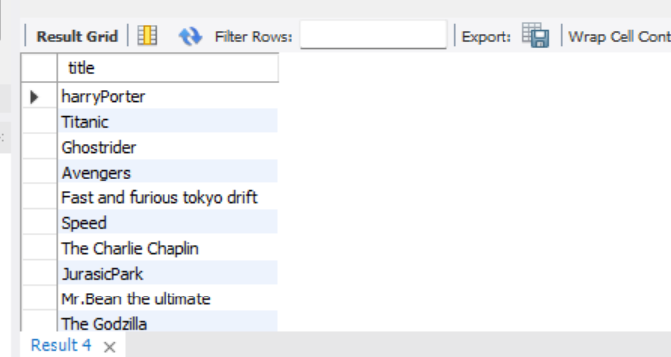
Write a query to find all movies directed by directors who were born after 1970. Use a subquery in the WHERE clause to find these DirectorIDs.
select title from movies m join moviedirectors r on m.movieid = r.movieid where directorid in (select directorid from directors where birthyear>1970);

